Slide 1
Advanced voting machine
-The smarter solution to modern voting system

Slide 2
Objective:
We often have seen in voting systems of our country that fake votes or votes from duplicate or fake voter ID cards are also taken into account.These votes in turn counted and resulted in the winning of the non dserving parties.To reduce such illegal process in the system we would like to suggest it a better and former solution.

Slide 3
Problems we are facing:
Todays system is generally very slow a lot of verification needs to checked before vote is to be given which takes lots of time.
The votes given in the EVM are also not counted compuratized ,rather by hands itself from the chits being printed out which can be an illegal issue.
The cards can be easily made duplicated and one can make their entry in the EVM by providing duplicate details no special checking feature of the individual or the card.

Slide 4
Components we have used:
Adafruit Fingerprint Sensor
Keypad(2)
Lcd screen
Servo Motor
Arduino Uno
Jumper Wires

Slide 5
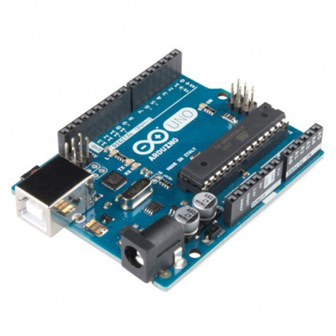
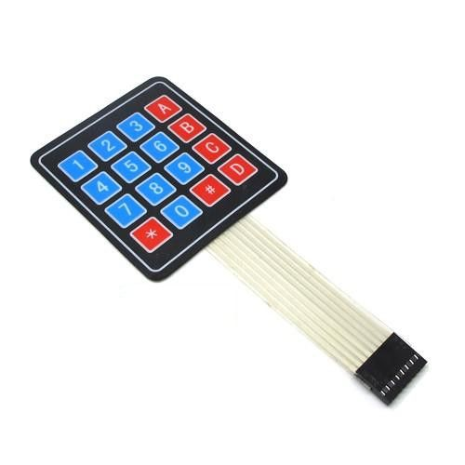
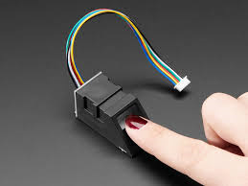
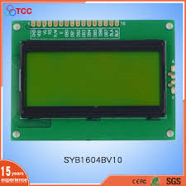
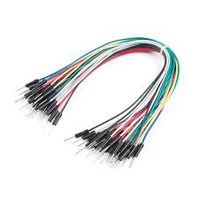

Slide 6
Working :
Fingerprint matched with adhar or not.(Ist Layer)
Voter id no valid or not
Checking the data inside it

Slide 7
Advantages of System:
Here we check the identity of the person with fingerprint if its linked with adhar or not.(Ist step of verification).
Here we also check the validity of the voter card in the database of this year(2nd step of security)
If and only if both the functions are passed the user is allowed to vote.
The vote is also taken digitally and counted digitally and printed on the screen with a message.

Slide 8
Cost Involved:
Adafruit Fingerprint Sensor 1100
Keypad(2) 60
Lcd screen 300
Servo Motor 80
Arduino Uno 330
Jumper Wires 50
----------------
1820/-

Slide 9
Conclusion:
The government should introduce these type of machines in India to reduce corruption that is taking place and reduce the duplicity of illegal voting for a safe and trustable vote thus choosing the perfect leader for our country or state.
Which will be the complete choice of the citizens of our country.

Slide 10
Thank you

